Slide 1
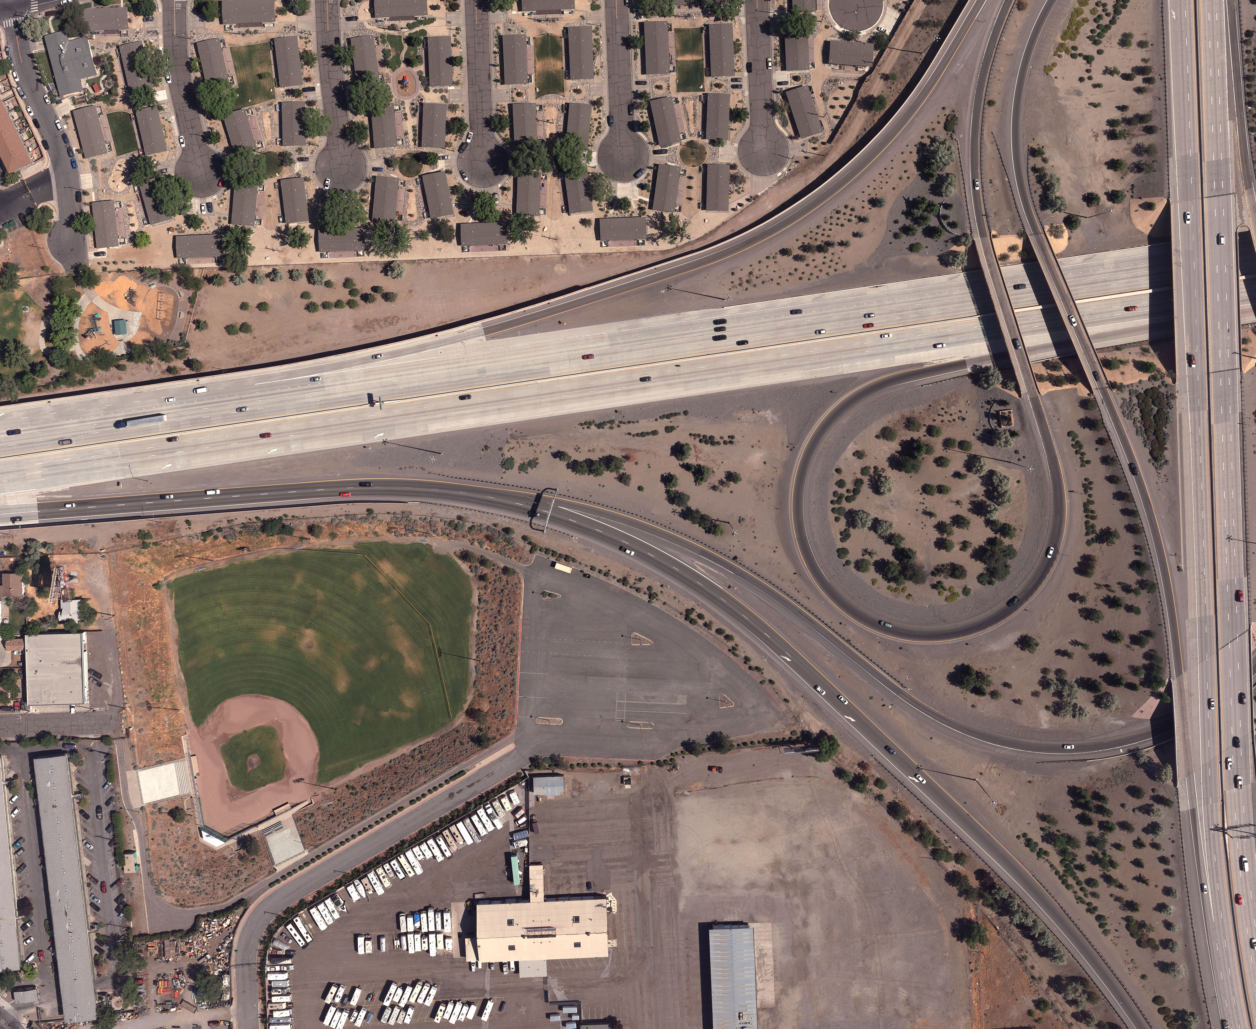
SPARKS CITY COUNCIL
March 11, 2019

Slide 2
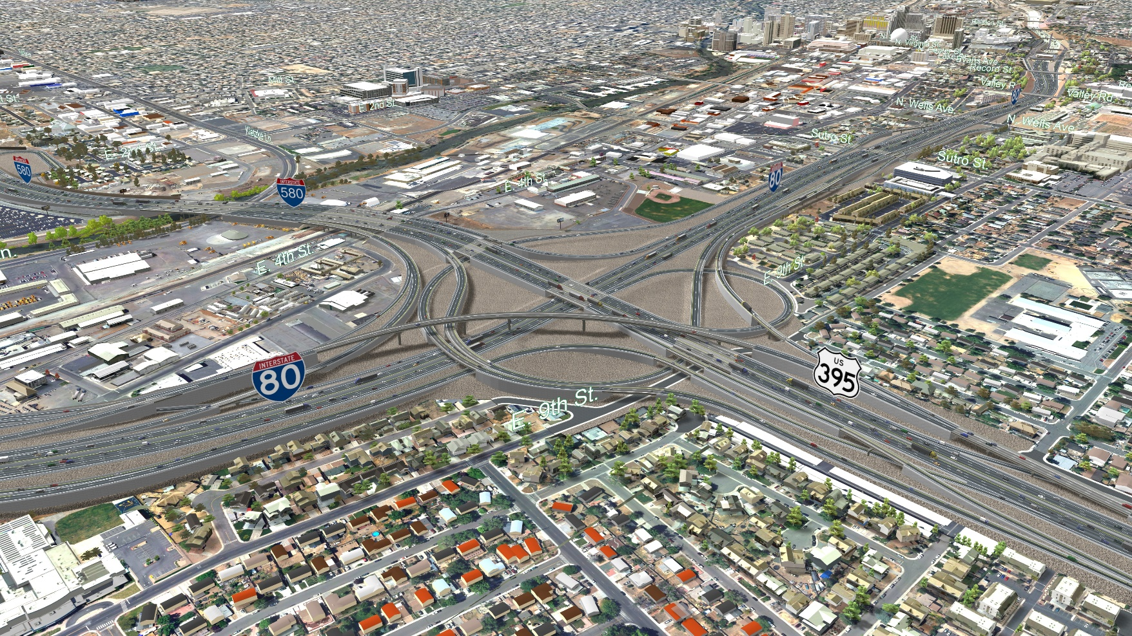
PREFERRED ALTERNATIVE
Alternative 2 identified as the Preferred Alternative
446 comments received
85% support Preferred Alternative
Only 1 comment opposed the Preferred Alternative
All Information is Preliminary and Subject to Change

Slide 3
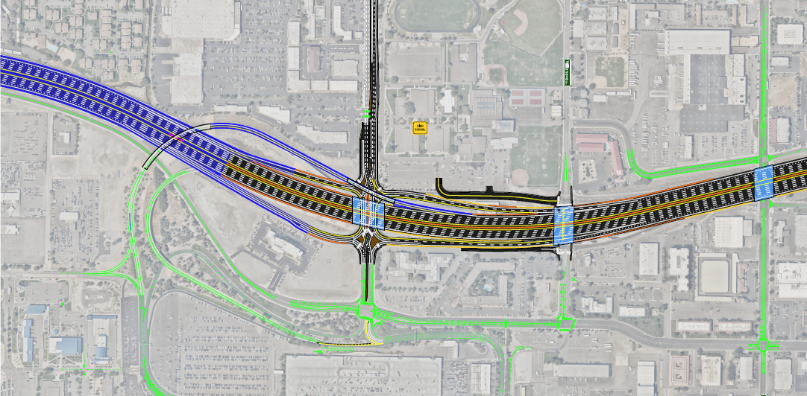
AIRPORT DIRECT ACCESS RESOLUTION
NDOT & Airport Authority Endorse Resolution
Airport Authority Board signed resolution on Feb. 14th
NDOT incorporated feedback from public comment (370+ comments in support of direct access)
Preferred Alternative will retain the southbound I-580 direct connector ramp
No additional environmental impacts to high school
All Information is Preliminary and Subject to Change

Slide 4
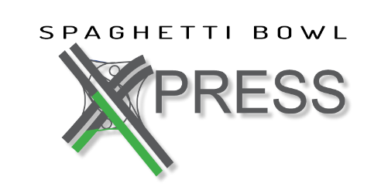
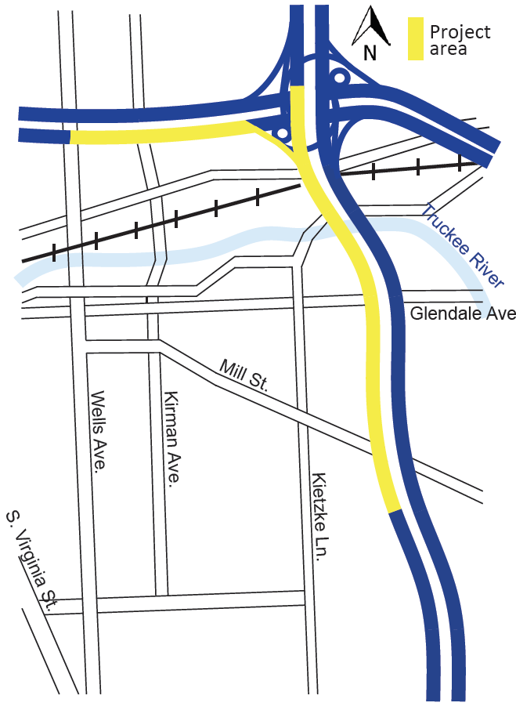
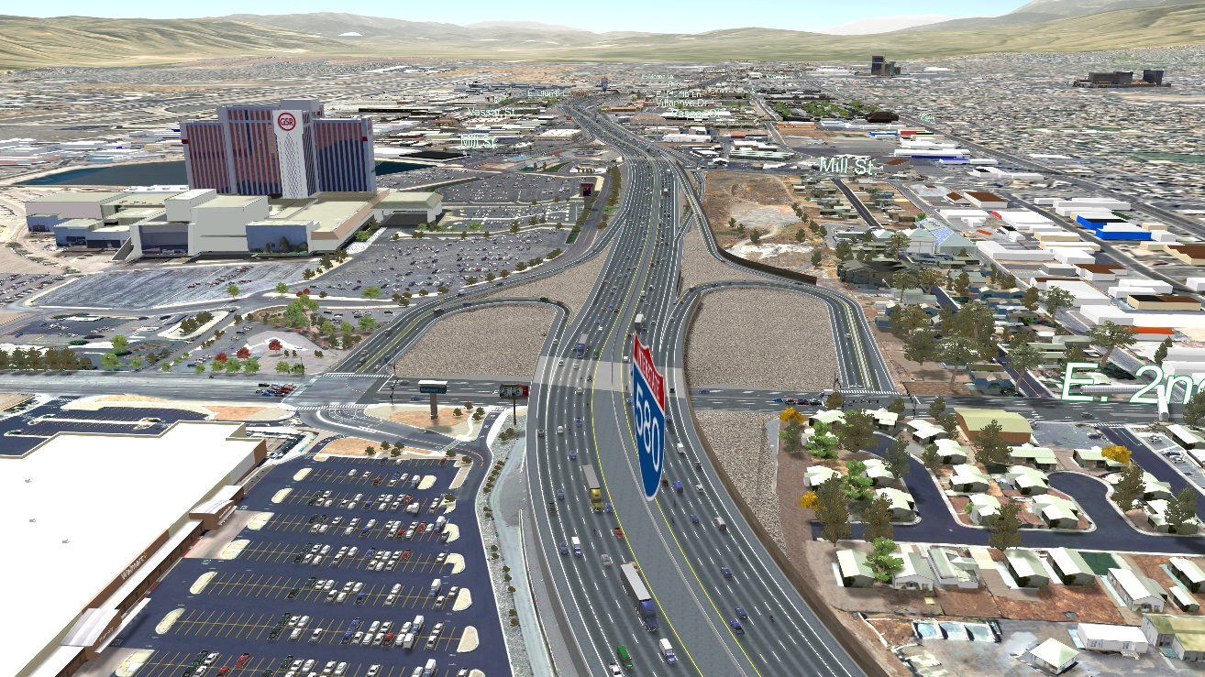
SPAGHETTI BOWL XPRESS
Phase 1 Construction
Design-Build Procurement underway
Construction Timeline: Early 2020 through 2022
Cooperative Agreement with City
All Information is Preliminary and Subject to Change

Slide 5
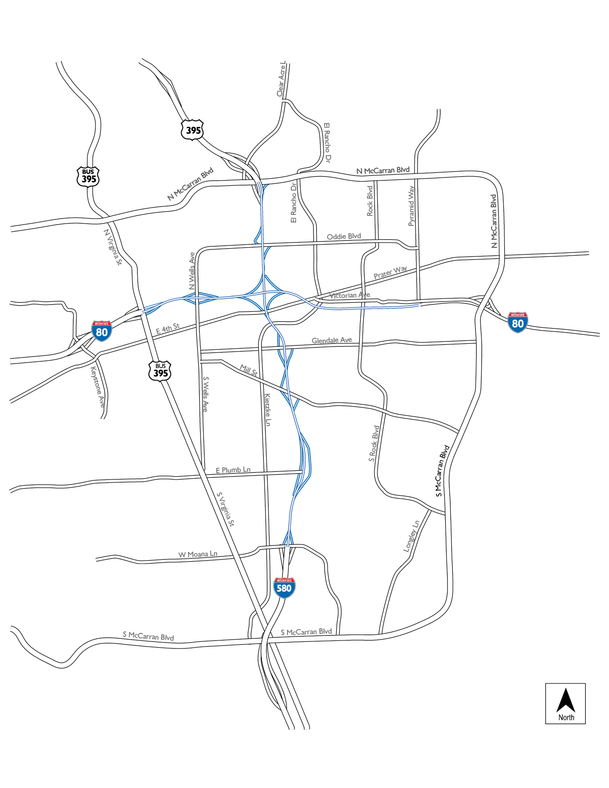
PROJECT PHASING
Construction is tentatively anticipated to occur in five phases
PHASE 1 (Spaghetti Bowl Xpress) (2020-2022)
Phase 2 (2023-2025)
Phase 3 (2027-2029)
Phase 4 (2035-2037)
Phase 5 (2037-2039)
All Information is Preliminary and Subject to Change

Slide 6
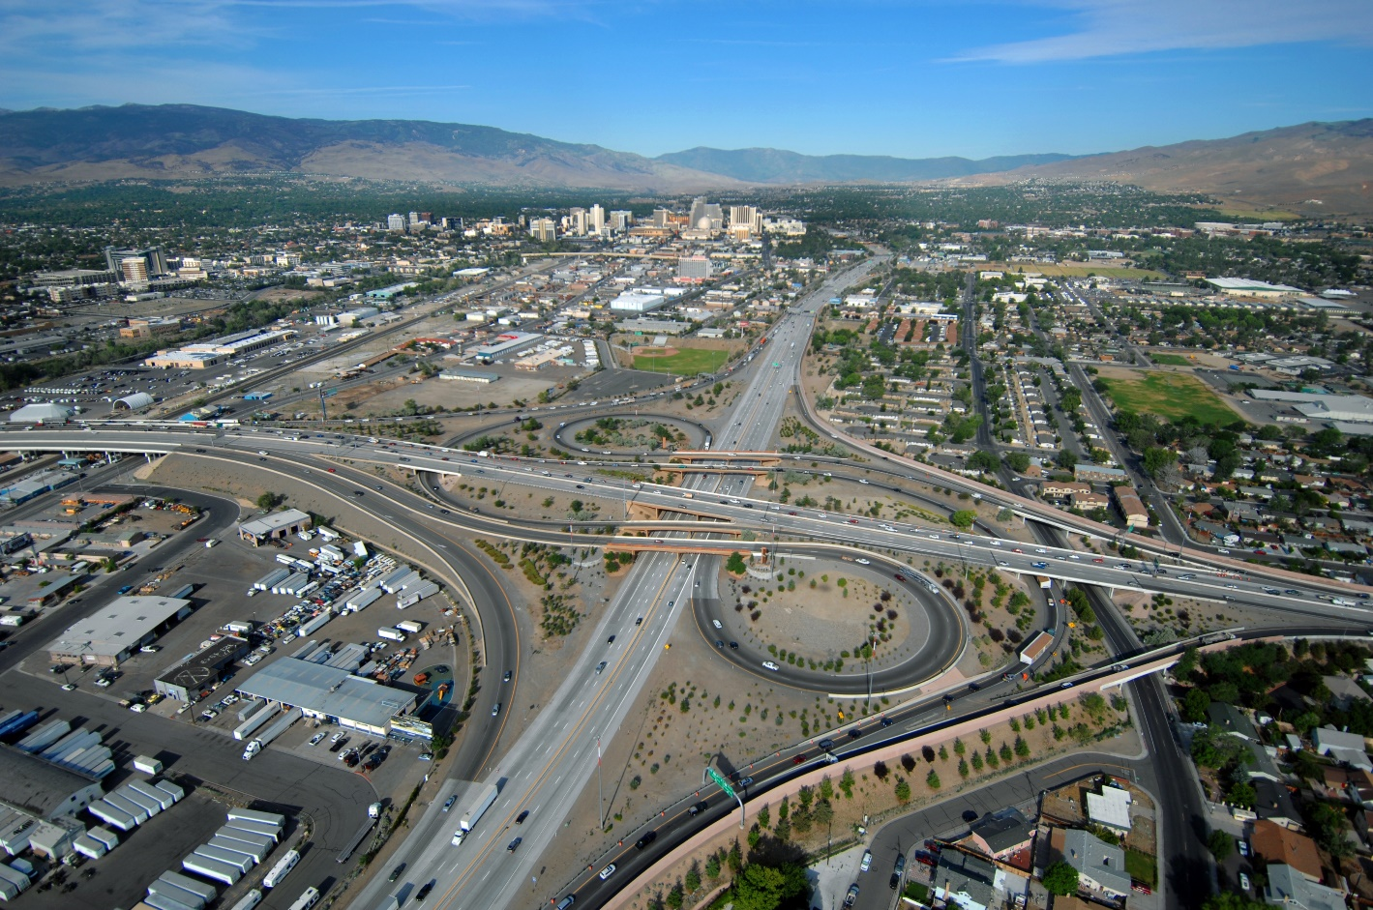
REQUESTING SUPPORT
NDOT requests a resolution of support for the Spaghetti Bowl Project from the City of Sparks.
Photo by Vaughn Hartung
All Information is Preliminary and Subject to Change

